Slide 1
IDOLATRY Definition of IDOLATRY
1: the worship of a physical object as a god
2: immoderate attachment or devotion to something
Definition of IDOLIZE
transitive verb
: to worship as a god; broadly : to love or admire to excess

Slide 2
Definition of IDOLIZE
transitive verb
: to worship as a god; broadly : to love or admire to excess
Definition of IDOLATROUS
1: of or relating to idolatry
2: having the character of idolatry
3: given to idolatry

Slide 3
Here is what Yahweh says in His word.
Ex 20:3-4 (NIV) "You shall have no other gods before me. You shall not make for yourself an idol in the form of anything in heaven above or on the earth beneath or in the waters below."

Slide 4
Jas 4:4 You people are not faithful to God! You should know that loving what the world has is the same as hating God. So anyone who wants to be friends with this evil world becomes God's enemy.
Jas 4:5 Do you think the Scriptures mean nothing? The Scriptures say, "The Spirit God made to live in us wants us only for himself.

Slide 5
Deut 29:18 (NIV) Make sure there is no man or woman, clan or tribe among you today whose heart turns away from the Lord our God to go and worship the gods of those nations; make sure there is no root among you that produces such bitter poison.

Slide 6
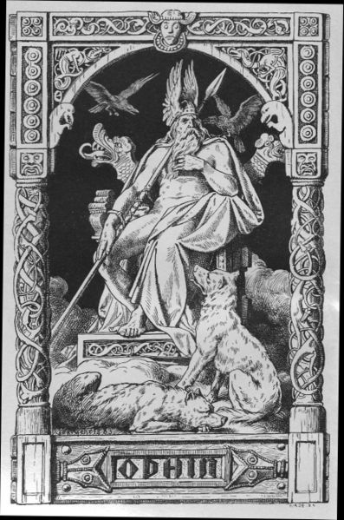
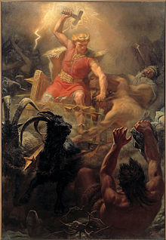
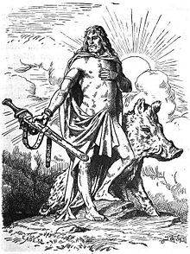
ODIN FRIGG THOR
NORDIC GOD’S EVOLVED FROM GERMANIC RELIGION

Slide 7
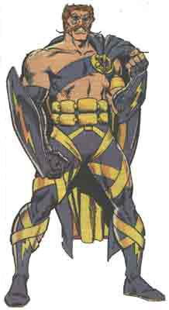
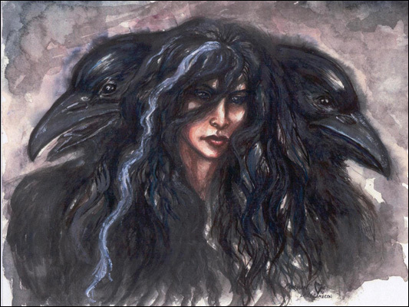
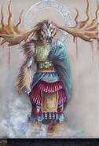
CELTIC GOD’S

Slide 8
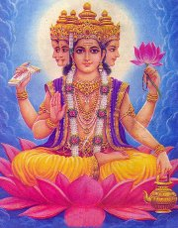
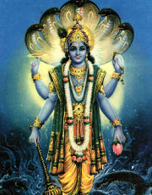
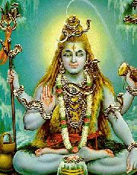
Examples of Idolatry
False Gods: Doctrines of Demons
Brahma Vishnu Shiva

Slide 9
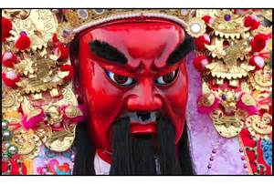
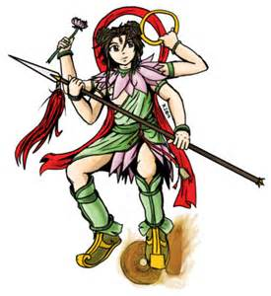
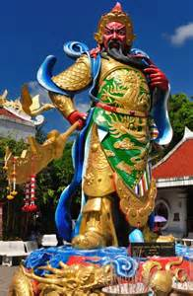
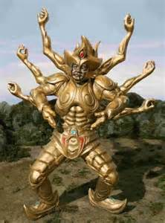
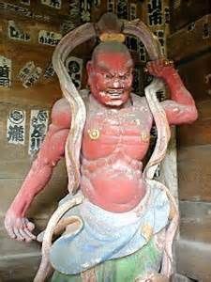
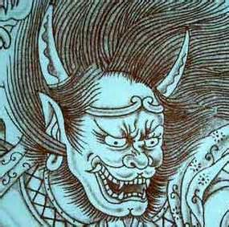

Slide 10
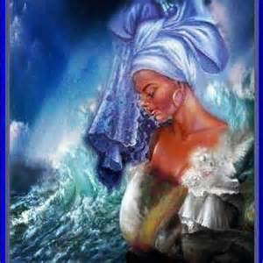
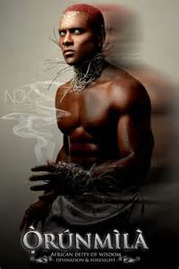
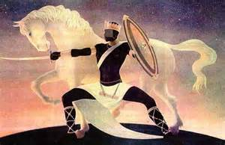
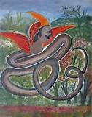
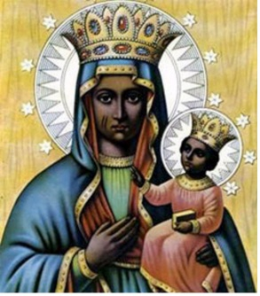
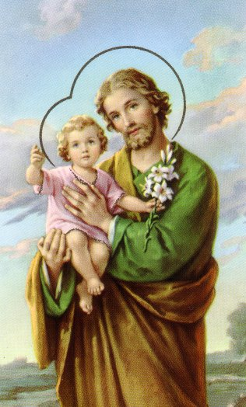

Slide 11
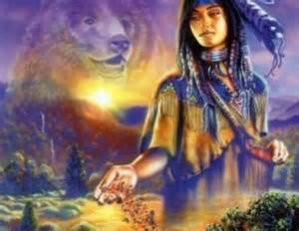
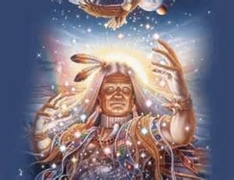
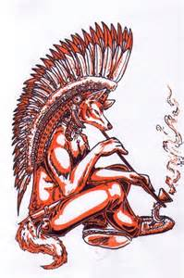
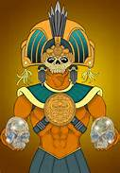
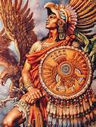
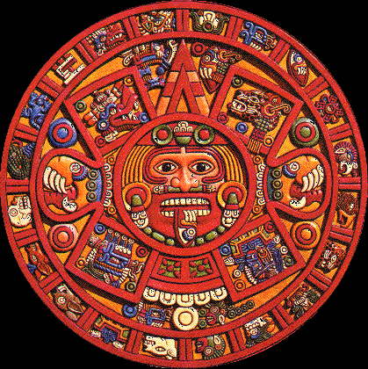

Slide 12
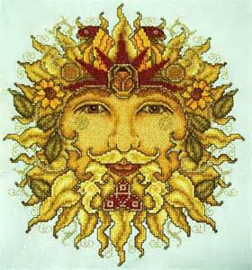
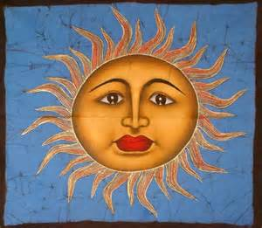
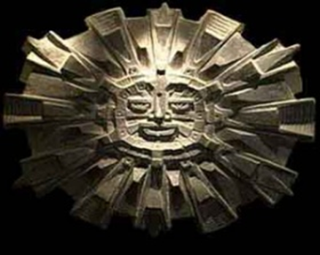
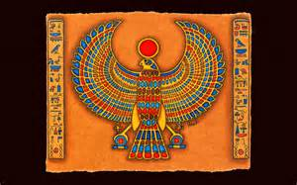
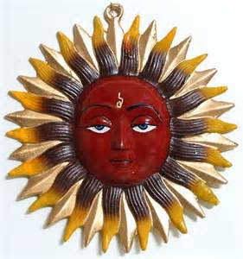
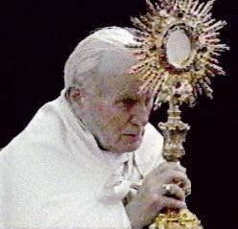

Slide 13
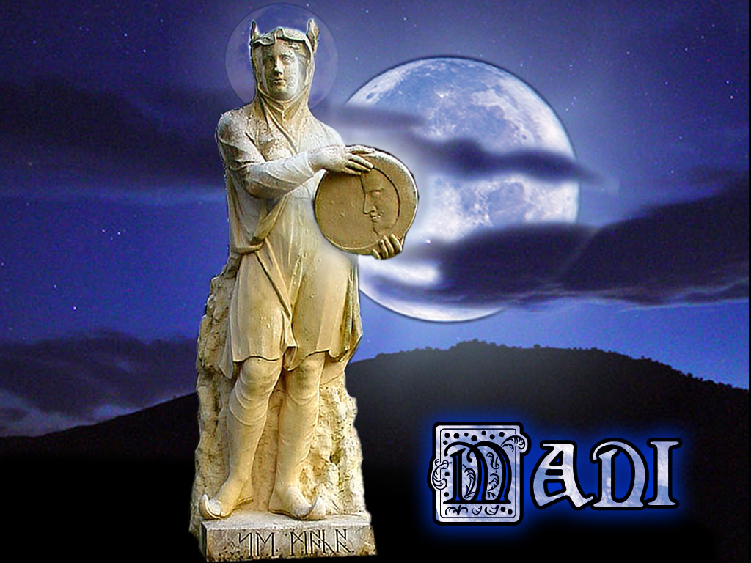
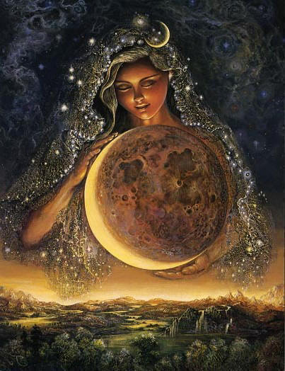
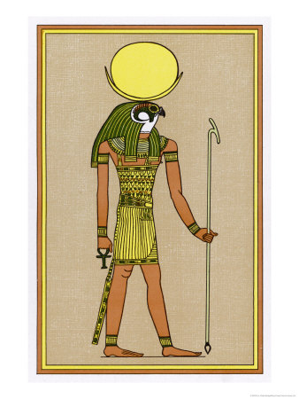
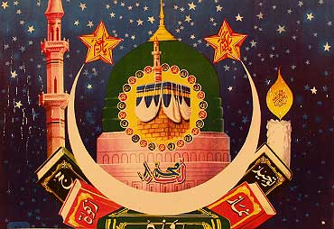
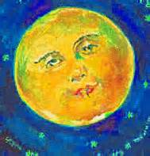

Slide 14
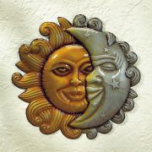

Slide 15
JEHOVAH WITNESS- BELIEF THAT JESUS IS THE ARCHANGEL MICHAEL
MORMONS –BELIEF THAT JESUS IS THE BROTHER OF LUCIFER
1Jn_4:3 And every spirit that confesseth not that Jesus Christ is come in the flesh is not of God: and this is that spirit of antichrist, whereof ye have heard that it should come; and even now already is it in the world.

Slide 16
ISLAM-DENIES GOD HAS A SON
CATHOLIC CHURCH- WORSHIP OF SAINTS
WORSHIP OF MARY
WORSHIP OF POPE

Slide 17
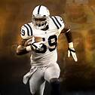
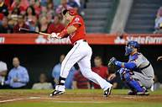
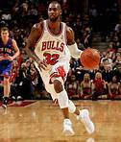
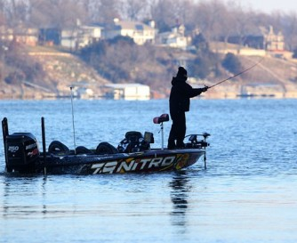
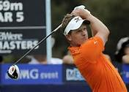

Slide 19
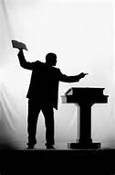

Slide 21
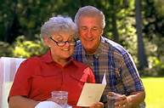

Slide 23
GOLF TENNIS FOOTBALL BASEBALL BASKETBALL TELEVISION HUNTING FISHING
SHOPPING
HUSBAND WIFE CHILDREN PASTOR FRIENDS MOTHER FATHER TALENTS
MUSIC MINISTRY GOD’S GIFTS MADE MORE IMPORTANT THAN GOD
LOOKS
MONEY

Slide 24
WHAT OR WHOM ARE YOUR IDOLS?
? ? ? ? ? ? ? ? ? ?

Slide 25
THE IDOL OF SELF IDOLATRY PLACING OURSELVES OUR OPINIONS ,EMOTIONS AND WILL IN POSITIONS CONTRARY TO THE WORD OF GOD.
JUSTIFYING OUR OWN SINFUL BEHAVIOUR BECAUSE OF CIRCUMSTANCES BROUGHT ON BY OTHERS,OUR ANCESTRY OR JUST BECAUSE WE FELL LIKE IT.
REFUSING TO ALLOW THE HOLY SPIRIT TO CONVICT AND CHANGE US EVEN WHEN WE KNOW RIGHT FROM WRONG

Slide 26
The Lust For Idols--A Matter of The Heart
Col 3:5 You must put to death, then, the earthly desires at work in you, such as sexual immorality, indecency, lust, evil passions, and greed (for greed is a form of idolatry).
Col 3:6 Because of such things God's anger will come upon those who do not obey him.
EXCUSES FOR IDOLATRY
But Everyone Else Is Doing It…

Slide 27
2 Ki 17:15 (NIV) They rejected his decrees and the covenant he had made with their fathers and the warnings he had given them. They followed worthless idols and themselves became worthless. They imitated the nations around them although the Lord had ordered them, "Do not do as they do," and they did the things the Lord had forbidden them to do.

Slide 28
2 Ki 17:40-41 (NIV) They would not listen, however, but persisted in their former practices. Even while these people were worshipping the Lord, they were serving their idols. To this day their children and grandchildren continue to do as their fathers did.
Public Image--Making Idols Of Men
1 Sam 15:23 (NIV) For rebellion is like the sin of divination, and arrogance like the evil of idolatry

Slide 29
Acts 8:9 (NIV) Now for some time a man named Simon had practiced sorcery in the city and amazed all the people of Samaria. He boasted that he was someone great.
Isa 42:8 (NIV) "I am the Lord; that is my name! I will not give my glory to another or my praise to idols.“
2 Pet 2:18 (NIV) For they mouth empty, boastful words and, by appealing to the lustful desires of sinful human nature, they entice people who are just escaping from those who live in error.

Slide 30
Do We Take Idolatry As Seriously As God?
Eze 6:4-6 (NIV) "... I will slay your people in front of your idols. I will lay the dead bodies of the Israelites in front of their idols, and I will scatter your bones around your altars... your idols smashed and ruined, your incense altars broken down, and what you have made wiped out."

Slide 31
1 Cor 6:9-10 (NIV) Do you not know that the wicked will not inherit the kingdom of God? Do not be deceived: Neither the sexually immoral nor idolaters nor adulterers nor male prostitutes nor homosexual offenders nor thieves nor the greedy... (Rom 1:23-25)
Eph 5:5 (NIV) For of this you can be sure: No immoral, impure or greedy person--such a man is an idolater--has any inheritance in the kingdom of Christ and of God

Slide 32
Spiritual Adultery
Isa 57:5-8 (NIV) "You burn with lust among the oaks and under every spreading tree... The idols... are your portion; they, they are your lot... You have made your bed on a high and lofty hill... Behind your doors and your doorposts you have put your pagan symbols. Forsaking me, you uncovered your bed, you climbed into it and opened it wide..."

Slide 33
Isa 57:10-11 (NIV) "You were wearied by all your ways, but you would not say, 'It is hopeless.' You found renewal of your strength, and so you did not faint. Whom have you so dreaded and feared that you have been false to me, and have neither remembered me nor pondered this in your hearts? Is it not because I have long been silent that you do not fear me?"

Slide 34
." Ezekiel is Grabbed By The Hair and Shown "Inside" The Temple Of God
Eze 8:5-6 (NIV) ..."Son of man, look toward the north." So I looked, and in the entrance north of the gate of the altar I saw this idol of jealousy. And he said to me, "Son of man, do you see what they are doing--the utterly detestable things the house of Israel is doing here, things that will drive me far from my sanctuary? But you will see things that are even more detestable
Eze 8:5:7-10 (NIV) Then he brought me to the entrance to the court. I looked, and I saw a hole in the wall. He said to me, "Son of man, now dig into the wall."

Slide 35
and see the wicked and detestable things they are doing here." So I went in and looked, and I saw portrayed all over the walls all kinds of crawling things and detestable animals and all the idols of the house of Israel.
Eze 8:12,15 (NIV) He said to me, "Son of man, have you seen what the elders of the house of Israel are doing in the darkness, each at the shrine of his own idol? They say, 'The Lord does not see us...'" He said to me, "Do you see this, son of man? You will see things that are even more detestable than this."Eze 8:16-18 (NIV) He then brought me into the inner court of the house of the Lord, and there at the entrance to the temple, between the portico and the altar, were about twenty-five men. With their backs toward the temple of the Lord and their faces toward the east, they were bowing down to the sun in the east. He said to me, "Have you seen this, son of man?

Slide 36
Is it a trivial matter for the house of Judah to do the detestable things they are doing here?... Look at them putting the branch to their nose! [witchcraft] Therefore I will deal with them in anger; I will not look on them with pity or spare them. Although they shout in my ears, I will not listen to them."
Eze 9:3-4 (NIV) Now the glory of the God of Israel went up from above the cherubim, where it had been, and moved to the threshold of the temple. Then the Lord called to the man clothed in linen who had the writing kit at his side and said to him, "Go throughout the city of Jerusalem and put a mark on the foreheads of those who grieve and lament over all the detestable things that are done in it."

Slide 37
Would You Qualify For This "Mark" In God's "Temple" Today?
Eze 9:5-7 (NIV) As I listened, he said to the others, "Follow him through the city and kill, without showing pity or compassion. Slaughter old men, young men and maidens, women and children, but do not touch anyone who has the mark. Begin at my sanctuary." So they began with the elders who were in front of the temple. Then he said to them, "Defile the temple and fill the courts with the slain. Go!" So they went out and began killing throughout the city.

Slide 38
2 Cor 6:16 (NIV) What agreement is there between the temple of God and idols? For we are the temple of the living God. As God has said: "I will live with them and walk among them, and I will be their God, and they will be my people.“

Slide 39
Repent Or Perish--A Greater Judgment Is Coming
A.W. Tozer: "Grace will save a man... but it will not save him and his idol."
Jonah 2:8 ( ISV) “Jon 2:8 Those who cling to vain idols leave behind the gracious love that could have been theirs.
1 Pet 4:3 (NIV) For you have spent enough time in the past doing what pagans choose to do--living in debauchery, lust, drunkenness, orgies, carousing and detestable idolatry.

Slide 40
Jas 4:7 Therefore submit yourselves to God. Resist the devil, and he will flee from you.
Jas 4:8 Draw near to God, and He will draw near to you. Cleanse your hands, sinners; and purify your hearts, double-minded ones.
Jas 4:9 Be afflicted, and mourn and weep. Let your laughter be turned to mourning and your joy to heaviness.
Jas 4:10 Be humbled before the Lord, and He will lift you up.

Slide 41
1 Cor 10:14 (NIV) Therefore, my dear friends, flee from idolatry.
OUR LORD IS AN EVER PRESENT HELP IN TIME OF NEED .WHEN WE REPENT AND TURN TO HIM HE CLEANSES.
Eze 36:25 (NIV) "I will sprinkle clean water on you, and you will be clean; I will cleanse you from all your impurities and from all your idols."

Slide 42
Eze 37:23 (NIV) "They will no longer defile themselves with their idols and vile images or with any of their offenses, for I will save them from all their sinful backsliding, and I will cleanse them. They will be my people, and I will be their God."

Slide 43
REPENTANCE
In the name of Yahshua (JESUS)Messiah the Nazarene I repent for all generational idolatry.
I repent for all personal and generational rebellion, stubbornness and disobedience that have contributed to any witchcraft in my life and in my generational line.
I repent for all envy and jealousy of minds, physical bodies and personalities of others.
I repent for any worship of myself and any need of personal recognition.
I repent for all envy and jealousy of the spiritual giftings and capacities of others.

Slide 44
I repent for myself and for those in my generational line who did not guard the gates of the spiritual and physical senses.
I repent for choosing my will above the will of the Almighty One.
CHOICES
I choose to owe no one anything, but to love.
I choose to cast off the work of darkness and to put on the armor of Light, the Messiah Yahshua (Jesus Christ), and to make no provision for the flesh, to fulfill its lust.
I choose to walk only according to the grace and anointing Yahweh has given to me.

Slide 45
I choose to walk in unity with my brothers and sisters in Yahweh.
I choose to follow Messiah, living a life of love, preferring others above myself.
I choose to yield and surrender my personal rights so that I might serve the Almighty Yahweh wholeheartedly.
I choose to be devoted to one another in brotherly love and to honor one another above myself.

Slide 46
PROMISES : BY YOUR GRACE LORD
I will never be lacking in zeal, but will keep my spiritual fervor, serving Yahweh.
I will be joyful in hope, patient in affliction, faithful in prayer.
I will share with Yahweh’s people who are in need.
I will practice hospitality.
I will bless those who persecute.
I will rejoice with those who rejoice and will mourn with those who mourn.
I will live in harmony with other believers. I will not be proud, but I will associate with people of low position.
I will not be conceited. I will not repay evil for evil.
I will have regard for the good things in sight of all men. I will live at peace with everyone.
I will not take revenge on others.

Slide 47
In JESUS name I command all ungodly spiritual beings and devices that have been empowered by my idolatry, rebellion, and jealousy, and the idolatry, rebellion and jealousy of my ancestors?
In JESUS name I disconnect myself from any evil network and I break all ungodly ties between the abode of the enemy ,other human beings and myself?
Lord Yahweh Elohim, I ask you to remove the generational tree of the knowledge of good and evil In JESUS name

Slide 48
O Yahweh in Jesus name I break the cords of death that have entangled me, the torrents of destruction that try to overwhelm me, the cords of sheol that have coiled around me, and the snares of death that have confronted me?
I am in agreement with the minister of Yahweh God that evil spirits have to leave me now in Jesus Name.
Deliverance

Slide 49
Prayer of Consecration:
Lord Father Yahweh.I surrender my whole life to You. I give you all that pertains to me.My family, finances, home ,property vehicles ,ministry, friends , church ,pastor ,teachers and opinions. I ask you to consecrate my life for holy living in Jesus name. I ask you to teach me how to walk in order and balance and to learn to simply agree with you in all things. I confess Jesus is Lord of all .I thank you in advance for your help in Jesus name.Amen

