Slide 1
Aliens, Scientist and DNA. Altering the Image of God in Man
Ecc 1:9
The thing that hath been, it is that which shall be; and that which is done is that which shall be done: and there is no new thing under the sun.

Slide 2
IN THE BEGINNING
Gen 1:26 And God said, Let us make man in our image, after our likeness: and let them have dominion over the fish of the sea, and over the fowl of the air, and over the cattle, and over all the earth, and over every creeping thing that creepeth upon the earth.
Gen 1:27 So God created man in his [own] image, in the image of God created he him; male and female created he them.
Gen 1:28 And God blessed them, and God said unto them, Be fruitful, and multiply, and replenish the earth, and subdue it: and have dominion over the fish of the sea, and over the fowl of the air, and over every living thing that moveth upon the earth.

Slide 3
SOMETHING HAPPENED
Gen 6:1 And it came to pass, when men began to multiply on the face of the earth, and daughters were born unto them,
Gen 6:2 That the sons of God saw the daughters of men that they [were] fair; and they took them wives of all which they chose.
Gen 6:3 And the LORD said, My spirit shall not always strive with man, for that he also [is] flesh: yet his days shall be an hundred and twenty years.

Slide 4
Sons of God
Many people have debated whether the “sons of God” refers to angels or men. The Hebrew words for the “sons of God” is B’nai Ha Elohim, which would means these are Heavenly beings, giving credence to them being fallen angels. And then we see the children of these sons of God and daughters of men were “mighty men” and of “renown.” They were also “giants.” Something in their genetics made them super-sized people. And I present to you was their fallen angelic parentage
A very simple observation is that when you breed a horse and a donkey you get a mule. No longer horse. No longer donkey.
Human with humans create humans. Almost all have heard of David and Goliath. Lets look at another key use of B’nai Ha Elohim

Slide 5
The Bible is self-confirming and one passage of Scripture can always be confirmed by another. Here is term “sons of God” next used in the book of Job. Job 2:1 states: Again there was a day when the sons of God came to present themselves before the LORD, and Satan came also among them to present himself before the LORD.
The Hebrew term here once again is B’nai Ha Elohim. And as we know these sons of God here are clearly Angelic beings who are presenting themselves before The Lord (in Heaven). And Satan is among them (who of course is a fallen cherubim – a type of Heavenly being).

Slide 6
I believe that it is evident what this Hebrew term means. The implication here is that fallen angels married human women and produced children with them. And this act was so abhorrent to The Lord that He punished them. First with the flood and then with imprisonment.
THERE IS SOMETHING NEW ON THE EARTH. GOD DID NOT PRONOUNCE IT GOOD
Following are a few different Translations:

Slide 7
GEN.6: 1 AND 2
CEB The divine beings saw how beautiful these human women were, so they married the ones they chose.
CEV Some of their daughters were so beautiful that supernatural being came down and married the ones they wanted.
GNB When the human race had spread all over the world, and daughters were being born, some of the heavenly beings
saw that these young women were beautiful, so they took the ones they liked.

Slide 8
Gen 6:4 KJV There were giants in the earth in those days; and also after that, when the sons of God came in unto the daughters of men, and they bare children to them, the same became mighty (Gibbor) men which were of old, men of renown (shem Shame). CEB In those days, giants lived on the earth and also afterward, when divine beings and human daughters had sexual relations and gave birth to children. These were the ancient heroes, famous men.

Slide 9
The Nephilim were on the earth in those days, and also afterward, when the sons of God came in to the daughters of men, and they bore {children} to them. Those were the mighty men who {were} of old, men of renown .
New American Standard Version
The fallen ones were in the earth in those days, and even afterwards when sons of God come in unto daughters of men, and they have borne to them -- they [are] the heroes, who, from of old, [are] the men of name.
- Youngs Literal Bible

Slide 10
And GOD saw that the wickedness of man was great in the earth, and that every imagination of the thoughts of his heart was only evil continually.
6 And it repented the LORD that he had made man on the earth, and it grieved him at his heart.
7 And the LORD said, I will destroy man whom I have created from the face of the earth; both man, and beast, and the creeping thing, and the fowls of the air; for it repenteth me that I have made them.
.
9 These [are] the generations of Noah: Noah was a just man [and] perfect in his generations, [and] Noah walked with God

Slide 11
8 But Noah found grace in the eyes of the LORD. These are the generations of Noah: Noah was a just man and perfect in his generations, and Noah walked with God.
Noah was chosen to carry on and re-start humanity after the flood because he was a believer in God. Additionally he was “perfect in his generations” which seems to imply that his genetic bloodline and ancestry was 100% human.

Slide 12
Noah had not been a part of the Nephilim hybridization that was plaguing humanity. The Hebrew word for “perfect” in that verse is tamiym, which means “complete, whole” with reference to health and physical condition. This is the same word used to describe the condition of animal sacrifices to the Lord:
And whosoever offereth a sacrifice of peace offerings unto the LORD to accomplish his vow, or a freewill offering in beeves or sheep, it shall be perfect(tamiym) to be accepted; there shall be no blemish therein. – Leviticus 22:21.

Slide 13
( afterwards )
Deuteronomy 2:20 (That also was accounted a land of giants: giants dwelt therein in old time; and the Ammonites call them Zamzummims;
Numbers 13:33 And there we saw the giants, the sons of Anak, which come of the giants: and we were in our own sight as grasshoppers, and so we were in their sight.
Deuteronomy 3:13 And the rest of Gilead, and all Bashan, being the kingdom of Og, gave I unto the half tribe of Manasseh; all the region of Argob, with all Bashan, which was called the land of giants.

Slide 14
Joshua 17:15 And Joshua answered them, If thou be a great people, then get thee up to the wood country, and cut down for thyself there in the land of the Perizzites and of the giants, if mount Ephraim be too narrow for thee.
Deuteronomy 2:11 Which also were accounted giants, as the Anakims; but the Moabites call them Emims.
Joshua 15:8 And the border went up by the valley of the son of Hinnom unto the south side of the Jebusite; the same is Jerusalem: and the border went up to the top of the mountain that lieth before the valley of Hinnom westward, which is at the end of the valley of the giants northward:

Slide 15
Joshua 18:16 And the border came down to the end of the mountain that lieth before the valley of the son of Hinnom, and which is in the valley of the giants on the north, and descended to the valley of Hinnom, to the side of Jebusi on the south, and descended to Enrogel,
Joshua 13:12 All the kingdom of Og in Bashan, which reigned in Ashtaroth and in Edrei, who remained of the remnant of the giants: for these did Moses smite, and cast them out.
1 Samuel 17:4 And there went out a champion out of the camp of the Philistines, named Goliath, of Gath, whose height was six cubits and a span.
2 Samuel 21:19 AND there was again a battle in Gob with the Philistines, where Elhanan the son of Jaareoregim, a Bethlehemite, slew the brother of Goliath the Gittite, the staff of whose spear was like a weaver's beam.

Slide 16
2 Samuel 21:20 And there was yet a battle in Gath, where was a man of great stature, that had on every hand six fingers, and on every foot six toes, four and twenty in number; and he also was born to the giant.
Amos 2:9 “Yet it was I who destroyed the Amorite before them, whose height was like the height of the cedars and who was as strong as the oaks;
The Cedars if the middle east are huge trees,different from the small cedars in America. Cedars from Lebanon were used to construct the temple Jerusalem .Let's take a look at a picture or two for perspective,

Slide 17
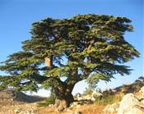
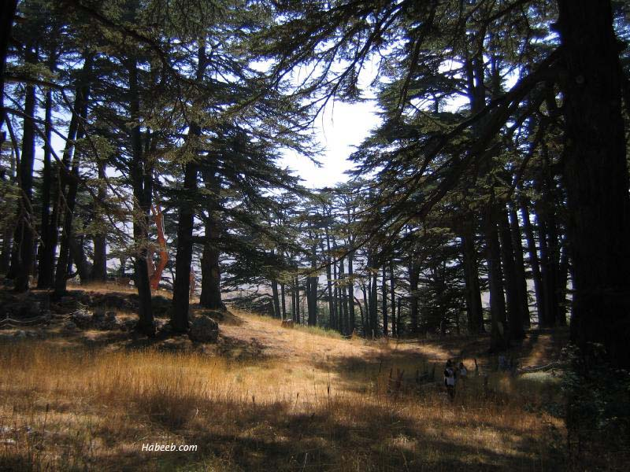

Slide 18
Time, along with the exploitation of the Cedars’ wood, has led to a decrease in the number of Cedar trees in Lebanon. However Lebanon is still known for its Cedars, as they are the emblem of the country and the symbol of the Lebanese flag.[5] Nevertheless, The trees survive in mountainous areas, where they are the dominant tree species. This is the case on the slopes of Mount Makmel that tower over the Kadisha Valley, where the Cedars of God are found at an altitude of more than 2,000 metres (6,600 ft). Four trees have reached a height of 35 metres (115 ft). and their trunks are 12–14 metres (39–46 ft) around.[1]

Slide 19
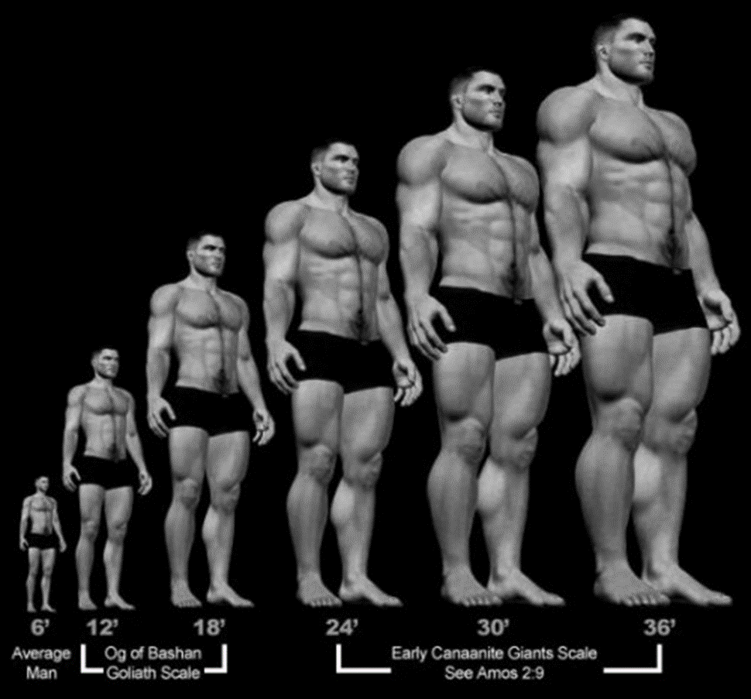

Slide 20
Other Mutations
In the extra canonical Books Of Enoch and Jasher the Fallen angel transgression is detailed along with other sins involving animals. Josephus an Jewish Historians confirms the giants. Lets take a look at some of the architectural evidence throughout the earth for Giants and Mixtures.

Slide 21
7 HANOCH – ENOCH 7 [1] And they took wives unto themselves, and everyone respectively chose one woman for himself, and they began to go unto them. And they taught them magical medicine, incantations, the cutting of roots, and taught them about plants.[2] And the women became pregnant and gave birth to great giants whose heights were three hundred cubits.

Slide 22
Enoch 7:3 These giants consumed the produce of all the people until the people detested feeding them.[4] So the giants turned against the people in order to eat them. [5] AND THEY BEGAN TO SIN AGAINST BIRDS, WILD BEASTS, REPTILES, AND FISH. And their flesh was devoured the one by the other, and they drank blood.

Slide 23
Physical Evidence Today- Archeology

Slide 24
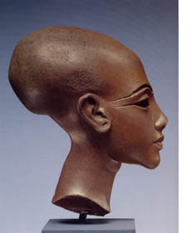
EGYPT

Slide 25
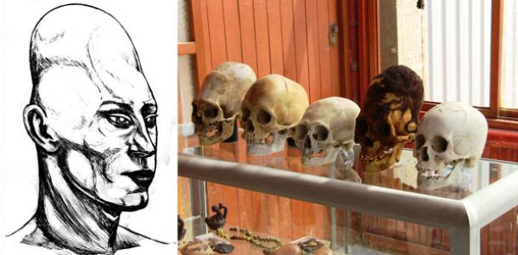
PERU

Slide 26
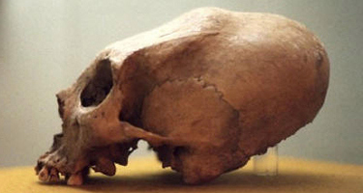
RUSSIA

Slide 27
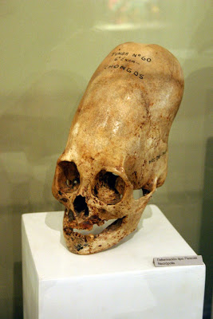
RUSSIA

Slide 28
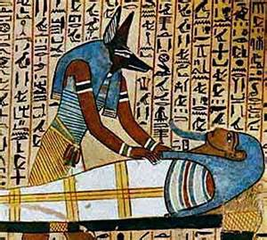
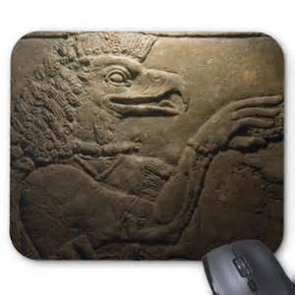
EGYPT

Slide 29
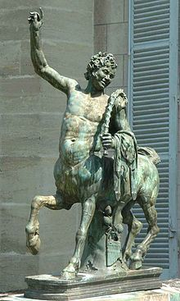
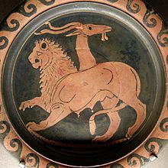
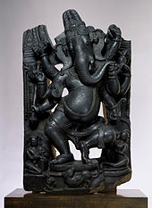
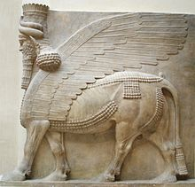
GREEK
HINDU
ASSYRIAN

Slide 30
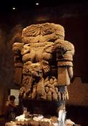
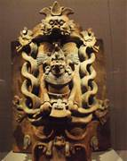
AZTEC MAYAN

Slide 31
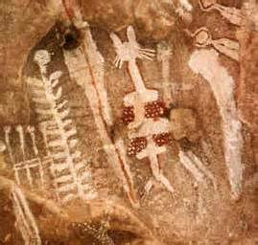
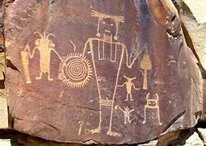
GRAND CANYON UTAH/COLORADO

Slide 32
The Trilithon at Baalbek
The three stones used in the temple base measure 290 feet long and 160 feet wide and weight an astonishing 750-800 tons each. Nearby, in a quarry, sits an unused stone that weighs 1200 tons. That's the weight of 3 passenger airplanes. How did these ancient masons (maybe Roman, but speculated to be much older than the Roman occupation) cut, transport, and lift these massive stones on top of other stones weighing 350 tons each?

Slide 33
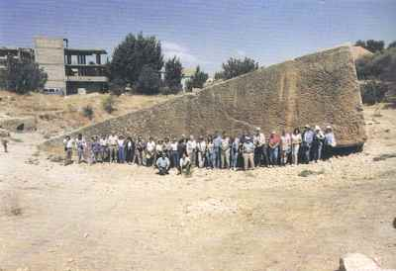

Slide 34
The Nazca Lines The real story behind the Nazca lines in Peru isn't the big shapes of monkeys and hummingbirds that get the tourists excited. True, their purpose can't be explained readily, but we know how those were made: you figure out a shape and dig until you get to the different colored rock. What's really interesting are the straight lines criss-crossing the plains. These stretch for up to 15 miles in some cases, but remain perfectly straight the entire way across. Also, you can only know the shapes from the air

Slide 35
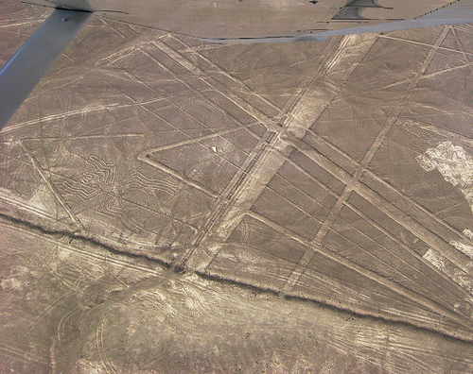

Slide 36
Sacsayhuamán
Again, in Peru, this massive fortress displays a knowledge of stonework that modern man is simply unable to duplicate. These walls of stone are cut and stacked in ways that boggle the mind, fitting together so precisely that even today the seams are so tight that a piece of paper or a razor blade can't fit between. All stacked without any mortar, held in place through sheer engineering. The stones can weight up to 360 tons, yet were carried from over 22 miles away using... we don't know. We don't know what carried these stones that far, we don't know what could lift them up in the air and on top of other massive stones, we don't know how they were cut in irregular puzzle shapes and then stacked together in such perfect precision.

Slide 37
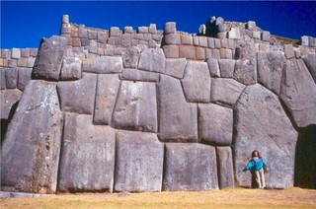

Slide 38
The Pyramids of Giza
We don't know why they were built, not sure really what all the chambers in them do (or if we've even found them all), aren't sure what's beneath them (theories say that enormous faces carved aside the pyramids are continually being covered by sand), and we have no idea how the enormous blocks were put in place, especially without mortar.
The blocks themselves were cut, carved, moved, and lifted miles away from the site, and the old problem of weight in building comes into play again; blocks this heavy would have crushed any sleds or tree trunk rollers that Egyptologists think moved them.

Slide 39
And that doesn't even explain what the interiors were for Why do they align with the stars in Orion's belt, or how the interiors were lit to paint the thousands of hieroglyphics on the walls deep in the pyramids. Torches would have produced soot on the roofs and walls, which is not found in the tomb at all and reflected light on mirrors would have dissipated after only a few feet.
Many structure built in ancient times have exact alignment to specific stars. How was this accomplished?

Slide 40
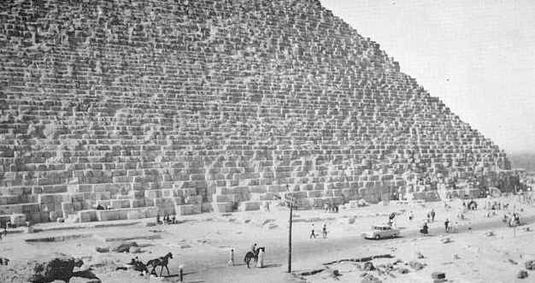
The Great Pyramid is composed of over 2 ½ million blocks of limestone which weigh from 2 to 70 tons each. Its base covers over 13 acres and its volume is around 90,000,000 cubic feet.

Slide 41
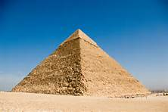

Slide 42
Puma Punka
A megalithic structure atop a 13,000 ft plateau in Bolivia with massive blocks fitting together like Legos -- again, without mortar. The age is estimated conservatively at about 2000 years old, but many people believe they are much older, with some guesses as early as 14,000 years old. The heaviest of these stones is 450 tons. What makes this even more amazing is that many of these blocks were cut from diorite, an insanely hard rock that was used in ancient times to cut other rocks. The grooves in the diorite are machine-made, some as small as a centimeter deep with only 1 mm variation. And all these blocks are cut like this. Even today's engineers are daunted by this task, and then carting them up a 13,000 ft mountain?

Slide 43
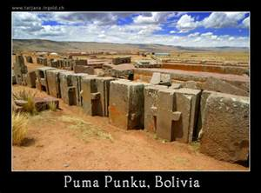

Slide 44
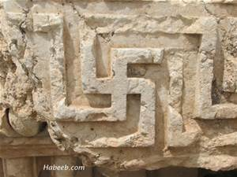

Slide 45
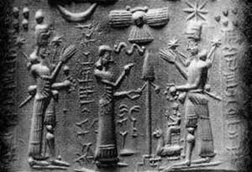

Slide 46
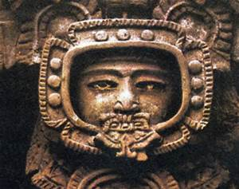

Slide 47
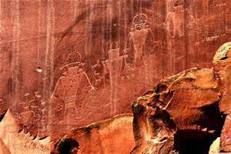

Slide 48
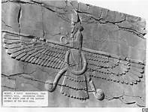

Slide 49
How Does This Apply To Us Today?
MATT 24:37 For as were the days of Noah, so will be the coming of the Son of Man.
LUKE 17:26 Just as it was in the days of Noah, so will it be in the days of the Son of Man. 27 They were eating and drinking and marrying and being given in marriage, until the day when Noah entered the ark, and the flood came and destroyed them all.

Slide 50
What about Aliens? UFO’s

Slide 51
The world about us today is proclaiming that we are being visited from outer space. Many are believing the story that humans were created by these visitors. Ancient cultural history and architectural evidence overwhelmingly points to beings superior to man in intelligence and technology have been here. I present to you that these beings were worshiped and still are worshipped in the form of the many false gods throughout the world .We have looked at some of the amazing architecture and carvings found throughout our planet.

Slide 52
Have you ever heard the saying that where there is smoke there is fire? Well Church there is smoke. A lot of smoke. Just get on line and do a you tube search on UFO’s. Of course some of these could be explained as the military vehicles of the world. Problems with this alone being the answer is that there are personal encounters over and over. At one time this could be dismissed as people that were delusional. I do not believe this to be true anymore. Some may be hoaxes but over and over people around the world over are being encountered by “Alien” beings. Too many to discredit.

Slide 53
Time after time people are being subjected to some form of reproductive harvesting. As Solomon said there is nothing new under the sun (GEN 6). Many respectable ministers of God are coming forth with testimony of encounters with these craft. There is testimony of them being rebuke able in the name of Jesus. That should be a sign to believers of their origin.

Slide 54
The world is being set up to believe that these beings who are no more or less than fallen angels are going to save mankind. I believe they will claim to be the answer . They will claim to be mans creators or that they are sent by God as a higher creation to rescue us from our own calamities.

Slide 55
The world is being set up to believe that these beings who are no more or less than fallen angels are going to save mankind. I believe they will claim to be the answer . They will claim to be mans creators or that they are sent by God as a higher creation to rescue us from our own calamities.

Slide 56
Consider this as an explanation for the following.
2Th 2:7 For the mystery of iniquity doth already work: only he who now letteth will let, until he be taken out of the way.
2Th 2:8 And then shall that Wicked be revealed, whom the Lord shall consume with the spirit of his mouth, and shall destroy with the brightness of his coming:

Slide 57
2Th 2:9 Even him, whose coming is after the working of Satan with all power and signs and lying wonders,
2Th 2:10 And with all deceivableness of unrighteousness in them that perish; because they received not the love of the truth, that they might be saved.
2Th 2:11 And for this cause God shall send them strong delusion, that they should believe a lie:

Slide 58
Matthew 24:24
For there shall arise false Christs, and false prophets, and shall shew great signs and wonders; insomuch that, if it were possible, they shall deceive the very elect.

Slide 59
Antichrist and False Prophet
Consider this about these two characters. Every Human being will go through judgment. Either the Judgment seat of Christ for the believers or the Final Great White Throne Judgment. Heb_9:27 And as it is appointed unto men once to die, but after this the judgment:
2Co_5:10 For we must all appear before the judgment seat of Christ; that every one may receive the things done in his body, according to that he hath done, whether it be good or bad.

Slide 60
Rev 20:11 And I saw a great white throne, and him that sat on it, from whose face the earth and the heaven fled away; and there was found no place for them. Rev 20:12 And I saw the dead, small and great, stand before God; and the books were opened: and another book was opened, which is the book of life: and the dead were judged out of those things which were written in the books, according to their works.

Slide 61
Antichrist (seed of the serpent) and False Prophet do not. Look at the following scripture. These creature go straight into the fire without Judgment
Rev_19:20 And the beast was taken, and with him the false prophet that wrought miracles before him, with which he deceived them that had received the mark of the beast, and them that worshipped his image. These both were cast alive into a lake of fire burning with brimstone.

Slide 62
Although man can go there the lake of fire was not made for man.
Mat_25:41 Then shall he say also unto them on the left hand, Depart from me, ye cursed, into everlasting fire, prepared for the devil and his angels: .

Slide 63
What is science up to?
Wickpedia Transhumanism (abbreviated as H+ or h+) is an international cultural and intellectual movement with an eventual goal of fundamentally transforming the human condition by developing and making widely available technologies to greatly enhance human intellectual, physical, and psychological capacities

Slide 64
.[1] Transhumanist thinkers study the potential benefits and dangers of emerging technologies that could overcome fundamental human limitations, as well as the ethics of developing and using such technologies. They predict that human beings may eventually be able to transform themselves into beings with such greatly expanded abilities as to merit the label "posthuman".[1]

Slide 65
"A common feature of transhumanism and philosophical posthumanism is the future vision of a new intelligent species, into which humanity will evolve, which will supplement humanity or supersede it." (Wikipedia)
"Transhumanist thinkers predict that human beings may eventually be able to transform themselves into beings with such greatly expanded abilities as to merit the label 'posthuman.' Transhumanism is therefore sometimes referred to as 'posthumanism' or a form of transformational activism influenced by posthumanist ideal." (Wikipedia)

Slide 66
"Transhumanists view human nature as a work-in-progress, a half-baked beginning that we can learn to remold in desirable ways. Current humanity need not be the endpoint of evolution. Transhumanists hope that by responsible use of science, technology, and other rational means we shall eventually manage to become posthuman, beings with vastly greater capacities than present human beings have." Transhumanist Values (Humanity+)

Slide 67
There are many reasons given for DNA manipulation. Many seem reasonable to the average Human. Humans want to extend there lives. They want to live disease free. They would like to eliminate deformities in children. All of these things seem right to man. How about vision like a hawk. How about a human able to run like a cheetah. What about being able to hear like a deer. What about a super soldier able to defeat the enemies of any given nation.
Much of the research is being done by the military. In America we have a program called Darpa.Look at the following description of this program.

Slide 68
The Defense Advanced Research Projects Agency (DARPA) has a $2 billion yearly budget for research into creating a super solider as well as developing a synthetic police force. Working with the human genome, DARPA hopes to manipulate certain gene expressions. In experimentation, DARPA and the military industrial pharmaceutical complex are using natural abilities that are enhanced through genetic engineering.
Some of the medical feats DARPA would like to enhance are the ability of military soldiers to regrow limbs destroyed in battle.

Slide 69
By eliminating empathy, the Department of Defense (DoD) hopes to “enhance” a soldier’s ability to “kill without care or remorse, shows no fear, can fight battle after battle without fatigue and generally behave more like a machine than a man.”
See more at: http://www.occupycorporatism.com/darpa-continues-human-experiments-to-create-military-super-soldiers/#sthash.Ufyf8oAa.dpuf

Slide 70
Scientists are researching the construction of soldiers that feel no pain, terror and do not suffer from fatigue as tests on the wiring of the human brain are furthered by Jonathan Moreno, professor of bioethics at Pennsylvania State University. Moreno is working with the DoD in understanding neuroscience.

Slide 71
http://www.theguardian.com/science/2008/apr/02/medicalresearch.ethicsofscience
First British human-animal hybrid embryos created by scientists
· Breakthrough could pave way for stem cell supply
· Move will aid research into untreatable conditions

Slide 72
Britain's first human-animal hybrid embryos have been created, forming a crucial first step, scientists believe, towards a supply of stem cells that could be used to investigate debilitating and so far untreatable conditions such as Alzheimer's disease, Parkinson's and motor neurone disease.
Lyle Armstrong, who led the work, gained permission in January from the Human Fertilisation and Embryology Authority (HFEA) to create the embryos, known as "cytoplasmic hybrids".

Slide 73
His team at Newcastle University produced the embryos by inserting human DNA from a skin cell into a hollowed-out cow egg. An electric shock then induced the hybrid embryo to grow. The embryo, 99.9% human and 0.1% other animal, grew for three days, until it had 32 cells.
Pro_14:12 There is a way which seemeth right unto a man, but the end thereof are the ways of death.
Pro_16:25 There is a way that seemeth right unto a man, but the end thereof are the ways of death.

Slide 74
http://gf2045.com/ Global Future 2045
Project Avatar, Android robotics, Anthropomorphic telepresence, Neuroscience, Mind theory, Neuroengineering, Brain-Computer Interfaces, Neuroprosthetics, Neurotransplantation, Long-range forecasting, Future evolution strategy, Evolutionary transhumanism, Ethics, Bionic prostheses, Cybernetic life-extension, Mid-century Singularity, Neo-humanity, Meta-intelligence, Cybernetic immortality, Consciousness, Spiritual development, Science and Spirituality.

Slide 75
Dr. Marvin Minsky — Immortal minds are a matter of time
Ray Kurzweil — Immortality by 2045
Dr. Ed Boyden — Extending ourselves beyond our brains
Dr. Robert Thurman — Inner science for merging our cybernetic and subtle bodies
Dr. Peter H. Diamandis — We are evolving into meta-intelligence group-minds

Slide 76
At the Global Future 2045 conference (GF2045) in New York City on June 15-16, 2013, emcee Philippe van Nedervelde said, “It used to be that the only sure things are death and taxes. Soon, it will just be taxes. And if we get to live and prosper forever, perhaps even taxes will one day go the way of the Dodo too.”
His statement was met with laughter. Who wants to live forever? The attendees of the GF2045 do, and these neuroscientists, neuroengineers, and futurists are dedicating their considerable resources to everlasting life.

Slide 77
Russian Mogul to 'Forbes' Billionaires: Limitless Lifespans Can Be Yours Katie Drummond Contributor I met with Itskov after the event and spoke with him about immortality—and his considerable resources.
is particular idea is a four-part attack against death, known as the Avatar Project. Avatar A will be achieved with the creation of a robot that can be controlled by our brains; Avatar B will be achieved when a brain can be transplanted to a synthetic body; Avatar C will be achieved after the contents of a person’s brain can be uploaded into a synthetic one. The project will end with the completion of Avatar D—the creation of a hologram that will replace bodies completely. (Itskov hopes to achieve this last milestone by 2045.)

Slide 78
The conferees were quite explicit. Watson -- hardly known for his shyness or tact -- proclaimed to the audience of nearly a thousand, "If we could make better human beings by knowing how to add genes, why shouldn't we do it?" (As for the "better human beings" he has in mind, he told a British film maker in 2003 that he considers ten percent of children "stupid," and would like to see them genetically modified. "If you really are stupid, I would call that a disease," Watson said. He went on to argue for using genetic techniques to prevent the births of "ugly girls." "People say it would be terrible if we made all girls pretty," he explained. "I think it would be great.")

Slide 79
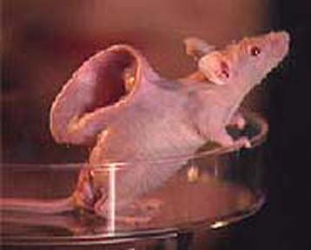

Slide 80
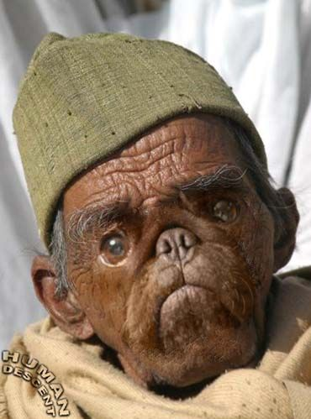

Slide 81
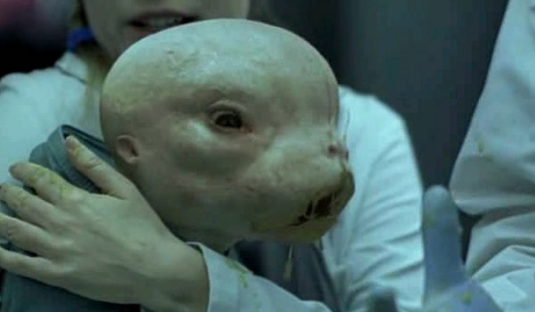

Slide 82
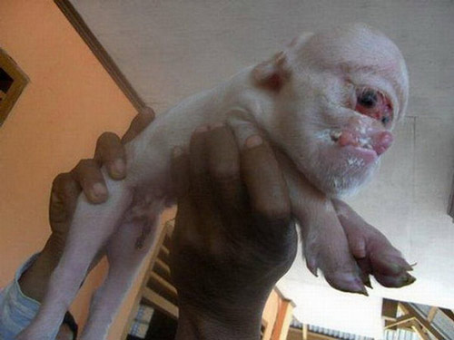

Slide 83
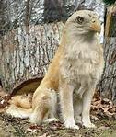
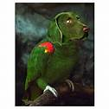

Slide 84
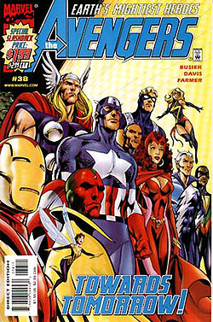
SPIRITUAL PREPARATION

Slide 85
labeled Earth's Mightiest Heroes, the Avengers originally consisted of Iron Man, Ant-Man, the Wasp, Thor, and the Hulk. The original Captain America was discovered, trapped in ice (issue #4), and joined the group after they revived him. A rotating roster became a hallmark, although one theme remained consistent: the Avengers fight "the foes no single superhero can withstand.“
http://en.wikipedia.org/wiki/Avengers_%28comics%29
Church this is just one example of countless. Man has the ability to change himself into something he was not meant to be. DNA change can be made even by injection.

Slide 86
Hidden Symbolism in Freemasonry
The Masonic Secret is a "sons of god with daughters of men" triple helix DNA upgrade!
Symbolic representations of the triplex structure for DNA may at times appear out of ignorance of the meaning behind it, yet a symbol is nonetheless a symbol. Should we care about symbols and being able to understand what they represent? YES! Demons are empowered by images, statues and symbols. Surely you know the practitioners of the Occult, secret societies and the Roman Catholic church are obsessed with them.

Slide 87
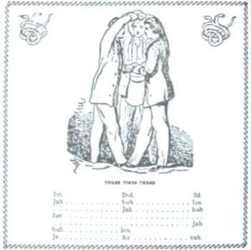
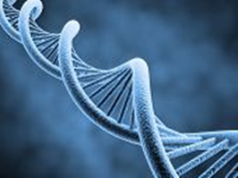
http://theopenscroll.blogspot.com/2009/11/masonic-secret-is-sons-of-god-with.html

Slide 88
Resources

Slide 89
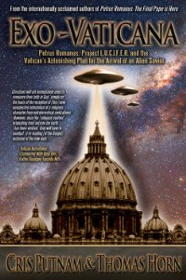
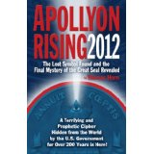
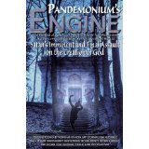
Http://www.raidersnewsupdate.com

Slide 90
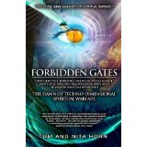
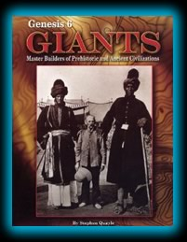
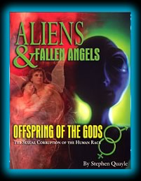
http://www.stevequayle.com

Slide 91
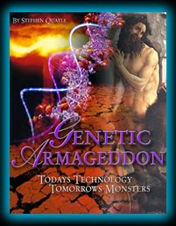
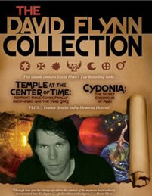

Slide 92
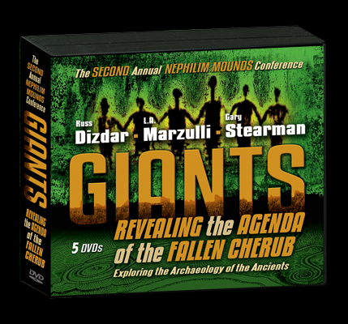

Slide 93
http://www.stevequayle.com/
http://lamarzulli.net/
http://www.genesis6giants.com/
http://raidersnewsupdate.com/

Slide 94
What is the point? Why should we know? What should we do?

Slide 95
The Point
The enemy from the point of the following prophetic word from Yahweh God has attemted to alter the image of God in Man.
Gen 3:15 And I will put enmity between thee and the woman, and between thy seed (antichrist)and her seed; it shall bruise thy head, and thou shalt bruise his heel.
The enemy from this point forward knew that one would come which would bring damage to his kingdom. His plan from that point forward was to eliminate the vessels which would bring forth His destroyer

Slide 96
First of all enemy forces mated with woman and created giants. They created mixtures of humans and animals. This was designed to eliminate the line of Adam from which God would bring the redeemer.
It happened before the flood and apparently after the flood.
The angels that sinned this way were punished by God by being sent to a compartment in the earth called Tartarus.
2Pe 2:4 For if God spared not the angels that sinned, but cast them down to hell, and delivered them into chains of darkness, to be reserved unto judgment;
2Pe 2:5 And spared not the old world, but saved Noah the eighth person, a preacher of righteousness, bringing in the flood upon the world of the ungodly;

Slide 97
Jud 1:6 And the angels which kept not their first estate, but left their own habitation, he hath reserved in everlasting chains under darkness unto the judgment of the great day.
Jud 1:7 Even as Sodom and Gomorrha, and the cities about them in like manner, giving themselves over to fornication, and going after strange flesh, are set forth for an example, suffering the vengeance of eternal fire.
The enemy having failed to destroy man as a whole began his program again after the flood. Many scholars believe that the tower of Babel was an attempt to bring more fallen angels to earth by opening a portal with the tower. Perhaps the next group of Giants came through This DNA change. Nimrod came from Canaan who Noah cursed. It was in Canaan land that the giants opposed Israel.

Slide 98
Take a look at the following from Gen 10:8 And Cush begat Nimrod: he began to be a mighty one in the earth.
Gen 10:9 He was a mighty hunter before the LORD: wherefore it is said, Even as Nimrod the mighty hunter before the LORD.
Became a gibbôr gibbôr
ghib-bore', ghib-bore'
Intensive from the same as H1397; powerful; by implication warrior, tyrant: - champion, chief, X excel, giant, man, mighty (man, one), strong (man), valiant man.
It appears that Nimrod was one thing and became another.

Slide 99
Next the enemy tried to destroy just one type of man. The Chosen people of Yahweh God from whom the Messiah would come from.
First through the Pharaoh having boy babies killed.
From Giant opposition in Canaan land
From attempting to get Israel to mix with other tribes. (when God said to kill every man.woman ,child and animal it was because these tribes were unredeemable because they were physically tainted)
With Goliath against David
With Haman against God’s people in Esther
With Herod against the boy babies in Rama

Slide 100
THE ENEMY THOUGHT HE HAD IT DONE AT THE CROSS
1Co 2:7 But we speak the wisdom of God in a mystery, even the hidden wisdom, which God ordained before the world unto our glory:
1Co 2:8 Which none of the princes of this world knew: for had they known it, they would not have crucified the Lord of glory

Slide 101
If altering the image of God in man was meant to stop Jesus from coming then what is going on now.
Now it is about souls. Jesus is the last Adam who came to redeem Adam. Every human who allows there DNA to be changed will know longer be of Adam and will no longer be redeemable. I believe this is the answer to the mystery of the Mark of the Beast. The Mark may very well involve technology and will be used to track purchasing.
Another aspect is the matter of salvation. Please look at the word of the Lord

Slide 102
Rev_13:16 And he causeth all, both small and great, rich and poor, free and bond, to receive a mark in their right hand, or in their foreheads:
Rev_13:17 And that no man might buy or sell, save he that had the mark, or the name of the beast, or the number of his name.
Rev_14:9 And the third angel followed them, saying with a loud voice, If any man worship the beast and his image, and receive his mark in his forehead, or in his hand,
Rev_14:11 And the smoke of their torment ascendeth up for ever and ever: and they have no rest day nor night, who worship the beast and his image, and whosoever receiveth the mark of his name.

Slide 103
Just as our God is a trinity that we know as Father ,Son and Holy Spirit the enemy has a trinity as well. This Trinity will manifest shortly as Satan, Antichrist and False Prophet. Satan always brings a counterfeit to the truth in order to deceive mankind. Satan will bring forth a seed from a woman either by physical relations or DNA change. This will be the antichrist. Just as Jesus was born of a woman so it is with Antichrist. As Jesus Father is Yahweh God the Antichrist father will be Satan. As the Holy Spirit testifies to Jesus so will the False Prophet point to the Anti Christ . As Jesus did miracles on the earth so will the Antichrist and False Prophet. The bible says we are children of the Light. We must understand that the world will be offered many good things in order to entice it to take the Mark.

Slide 104
WHY SHOULD WE KNOW?
1Th_5:5 Ye are all the children of light, and the children of the day: we are not of the night, nor of darkness.
Eph_5:8 For ye were sometimes darkness, but now are ye light in the Lord: walk as children of light:
1Co_4:5 Therefore judge nothing before the time, until the Lord come, who both will bring to light the hidden things of darkness, and will make manifest the counsels of the hearts: and then shall every man have praise of God.
2Co 2:11 Lest Satan should get an advantage of us: for we are not ignorant of his devices.
Amo 3:7 Surely the Lord GOD will do nothing, but he revealeth his secret unto his servants the prophets.

Slide 105
How Much Of The Bible Is Prophecy?
A. According to “The Encyclopedia of Biblical Prophecy” by J. Barton Payne, there are 1,239 prophecies in the Old Testament and 578 prophecies in the New Testament for a total of 1,817. These prophecies are contained in 8,352 of the Bible’s verses. Since there are 31,124 verses in the Bible, the 8,352 verses that contain prophecy constitute 26.8 percent of the Bible’s volume.

Slide 106
Isa 46:9 Remember the former things of old: for I am God, and there is none else; I am God, and there is none like me,
Isa 46:10 Declaring the end from the beginning, and from ancient times the things that are not yet done, saying, My counsel shall stand, and I will do all my pleasure:

Slide 107
WHAT ARE WE TO DO ?
Luk_21:28 And when these things begin to come to pass, then look up, and lift up your heads; for your redemption draweth nigh.
Eze_3:17 Son of man, I have made thee a watchman unto the house of Israel: therefore hear the word at my mouth, and give them warning from me
Eze_33:6 But if the watchman see the sword come, and blow not the trumpet, and the people be not warned; if the sword come, and take any person from among them, he is taken away in his iniquity; but his blood will I require at the watchman's hand.

Slide 108
Eph 6:10 Finally, my brethren, be strong in the Lord, and in the power of his might.
Eph 6:11 Put on the whole armour of God, that ye may be able to stand against the wiles of the devil.
Eph 6:12 For we wrestle not against flesh and blood, but against principalities, against powers, against the rulers of the darkness of this world, against spiritual wickedness in high places.
Eph 6:13 Wherefore take unto you the whole armour of God, that ye may be able to withstand in the evil day, and having done all, to stand.

Slide 109
Eph 6:14 Stand therefore, having your loins girt about with truth, and having on the breastplate of righteousness;
Eph 6:15 And your feet shod with the preparation of the gospel of peace;
Eph 6:16 Above all, taking the shield of faith, wherewith ye shall be able to quench all the fiery darts of the wicked.
Eph 6:17 And take the helmet of salvation, and the sword of the Spirit, which is the word of God:
Eph 6:18 Praying always with all prayer and supplication in the Spirit, and watching thereunto with all perseverance and supplication for all saints;

Slide 110
Father God, creator of heaven and earth, I come to You in the name of Jesus Christ Your Son. I come as a sinner seeking forgiveness and cleansing from all sins committed against You, and others made in Your image. I honour my earthly father and mother and all of my ancestors of flesh and blood, and of the spirit by adoption and god-parents, but I utterly turn away from and renounce all their sins. I forgive my ancestors for the effects of their sins on me and my children. I confess and renounce all of my own sins. I renounce and rebuke Satan and every spiritual power of his affecting me and my family.

Slide 111
I renounce and forsake all involvement in Freemasonry or any other lodge or craft by my ancestors and myself. I renounce witchcraft, the principal spirit behind Freemasonry, and I renounce Baphomet, the Spirit of Antichrist and the curse of the Luciferian doctrine. I renounce the idolatry, blasphemy, secrecy and deception of Masonry at every level. I specifically renounce the insecurity, the love of position and power, the love of money, avarice or greed, and the pride which would have led my ancestors into Masonry. I renounce all the fears which held them in Masonry, especially the fears of death, fears of men, and fears of trusting, in the name of Jesus Christ.

Slide 112
I renounce every position held in the lodge by any of my ancestors, including "Tyler", "Master", "Worshipful Master" or any other. I renounce the calling of any man "Master", for Jesus Christ is my only master and Lord, and He forbids anyone else having that title. I renounce the entrapping of others into Masonry, and observing the helplessness of others during the rituals. I renounce the effects of Masonry passed on to me through any female ancestor who felt distrusted and rejected by her husband as he entered and attended any lodge and refused to tell her of his secret activities."

Slide 113
1st Degree
"I renounce the oaths taken and the curses involved in the First or Entered Apprentice degree, especially their effects on the throat and tongue. I renounce the hoodwink, the blindfold, and its effects on emotions and eyes, including all confusion, fear of the dark, fear of the light, and fear of sudden noises. I renounce the secret word, BOAZ, and all it means. I renounce the mixing and mingling of truth and error, and the blasphemy of this degree of Masonry. I renounce the noose around the neck, the fear of choking and also every spirit causing asthma, hayfever, emphysema or any other breathing difficulty. I renounce the compass point, sword or sphere held against the breast, the fear of death by stabbing pain, and the fear of heart attack from this degree.

Slide 114
In the name of Jesus Christ, I now pray for healing of .......... (throat, vocal cords, nasal passages, sinus, bronchial tubes etc), for healing of the speech area, and the release of the Word of God to me and through me and my family."

Slide 115
2nd Degree
"I renounce the oaths taken and the curses involved in the second or Fellow Craft degree of Masonry, especially the curses on the heart and chest. I renounce the secret words JACHIN and SHIBBOLETH and all that these mean. I cut off emotional hardness, apathy, indifference, unbelief, and deep anger from me and my family. In the name of Jesus Christ, I pray for the healing of .......... (the chest/ lung/ heart area) and also for the healing of my emotions, and ask to be made sensitive to the Holy Spirit of God."

Slide 116
3rd Degree
"I renounce the oaths taken and the curses involved in the third or Master Mason degree, especially the curses on the stomach and womb area. I renounce the secret words MAHA BONE, MACHABEN, MACHBINNA and TUBAL CAIN, and all that they mean. I renounce the spirit of death from the blows to the head enacted as ritual murder, the fear of death, false martyrdom, fear of violent gang attack, assault, or rape, and the helplessness of this degree. I renounce the falling into the coffin or stretcher involved in the ritual of murder. I renounce the false resurrection of this degree, because only Jesus Christ is the resurrection and the life!

Slide 117
I also renounce the blasphemous kissing of the Bible on a witchcraft oath. I cut off all spirits of death, witchcraft and deception. In the name of Jesus Christ I pray for the healing of .......... (the stomach, gall bladder, womb, liver and any other organs of my body affected by masonry) and I ask for a release of compassion and understanding for me and my family."

Slide 118
I renounce the All-Seeing Third Eye of Freemasonry or Horus in the forehead and its pagan and occult symbolism. I renounce all false communions taken, all mockery of the redemptive work of Jesus Christ on the Cross of Calvary, all unbelief, confusion and depression, and all worship of Lucifer as God. I renounce and forsake the lie of Freemasonry that man is not sinful, but just imperfect, and so can redeem himself through good works. I rejoice that the Bible states that I cannot do a single thing to earn my salvation, but that I can only be saved by grace through faith in Jesus Christ and what He accomplished on the Cross of Calvary.

Slide 119
I receive healing from all of sickness, infirmity, curse, affliction, addiction, disease or allergy associated with these sins I have confessed and renounced and thank you Yahweh God
I ask you to fill me Lord with your Spirit, the spirit of wisdom and understanding, the spirit of counsel and might, the spirit of knowledge and of the fear of the LORD
In Jesus Name Amen

